Slide 1
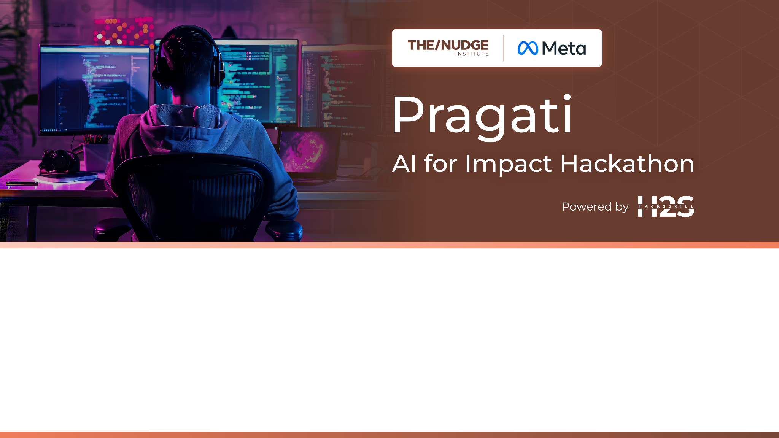
Team Name : hydra
Team Leader Name : Vivek Kumar Soni
Which domain does your idea address? (Agriculture / Healthcare / Skilling / Education): Healthcare

Slide 2

What is the problem you are solving? (50 words max)
In rural and underserved regions, limited access to hospitals, medical tools, and specialists results in many illnesses going undiagnosed due to irregular health checkups. This project addresses the need for early disease detection through a low-cost, AI-powered health monitoring system integrated with IoT technology.

Slide 3
Describe your solution. How different is it from any of the other existing ideas? How will it be able to solve the problem? USP of the proposed solution? What is the intended impact of your solution (max 350 words).
The proposed solution is a portable, AI-powered health monitoring system developed to tackle the lack of accessible healthcare in rural and underserved areas. In many such regions, there is limited availability of hospitals, medical equipment, and specialized doctors. As a result, people often miss out on regular checkups, and many common diseases remain undiagnosed until they become serious. Our system aims to solve this problem by providing on-the-spot, early detection of diseases using a compact, low-cost, and easy-to-use device.
The device integrates several biomedical sensors to measure vital health parameters including heart rate, ECG, blood pressure, blood oxygen levels, respiration rate, hemoglobin, glucose levels, body temperature, and hydration status. These measurements are analyzed using AI algorithms, which instantly detect signs of conditions like diabetes, hypertension, anemia, and lung diseases such as COPD or pneumonia. The device can operate without constant internet access and can store or transmit data through IoT when connectivity is available.
What sets this solution apart is its all-in-one functionality. While existing systems often require multiple separate instruments or trained professionals, this device simplifies diagnostics into a single step. It’s affordable, battery-efficient, and suitable for low-resource environments, making it ideal for use in remote villages by community health workers or even individuals themselves.
The unique selling points (USP) include:
Multiple health tests in a single, portable device
Real-time AI-powered analysis without specialist involvement
Low production and operational cost
IoT-based data sharing for remote consultation
The intended impact of this solution is to bring preventive healthcare closer to those who need it the most. By enabling regular monitoring and early detection, the system reduces the chances of severe illness, minimizes emergency hospital visits, and improves long-term health outcomes. It empowers communities with timely information and supports health workers with intelligent, actionable insights, ultimately bridging the gap in rural healthcare delivery.

Slide 4
Who is the primary user of your solution, and explain how your solution will leverage open-source AI to address the aspects mentioned in the Key Design Guidelines (max 200 words).
The primary users of our solution are community health workers, rural clinics, and individuals in remote areas who lack access to regular medical facilities. These users often cannot afford frequent hospital visits or do not have specialists nearby, making early diagnosis of common diseases difficult.
To solve this, our system uses open-source AI technologies to analyze real-time health data collected from sensors. By using platforms like TensorFlow Lite or ONNX, the AI can run directly on the device, even without internet access. This supports the offline-first requirement for rural environments.
Open-source AI offers flexibility, transparency, and cost-efficiency, helping us build a solution that meets the Key Design Guidelines such as affordability, privacy, local adaptability, and scalability. The AI models are trained on publicly available datasets and can be improved by local health experts to match regional health trends.
This approach empowers frontline health workers with instant, AI-powered insights and enables preventive healthcare, reducing the burden on distant hospitals and improving community well-being.

Slide 5
How is this solution scalable? (100 words max)
The solution is scalable due to its modular design, low cost, and use of open-source AI tools. The device can be mass-produced using affordable sensors and deployed in large numbers across rural regions. Since the AI runs on edge devices, there's no need for heavy infrastructure or constant internet, making it ideal for remote areas. Updates to the AI model can be distributed remotely or offline. Additionally, the system supports data integration with national health databases, allowing governments or NGOs to scale its use for community-wide health monitoring and preventive care.

Slide 6
List of features offered by the solution
It is always better to add a few visual representations (drawings/sketches/illustrations etc.) to your presentation, it adds to the power through which it reaches the audience.
List of Features Offered by the Solution
Portable Multi-Sensor Device
Compact and easy to carry for use in rural and remote areas.
Vital Sign Monitoring
Tracks heart rate, ECG, blood pressure, blood oxygen (SpO₂), and respiration rate.
Disease Detection
AI-based analysis detects early signs of diabetes, hypertension, anemia, and lung diseases.
Non-Invasive Readings
Uses sensors and NIR spectroscopy for painless, real-time health monitoring.
AI-Powered Offline Diagnostics
AI models run on the device without needing internet access.
IoT Connectivity
When available, syncs data to cloud or health databases for remote access.
User-Friendly Interface
Simple display with color-coded alerts for health status.
Rechargeble and Low Power Usage
Suitable for areas with limited electricity.
Customizable & Open-Source AI Models
Easily adaptable to local health conditions.

Slide 7
What open-source AI tools and technologies will you use to design the solution? (Please list all.)
To design the solution, we will use a combination of open-source AI tools, frameworks, and libraries that support efficient, offline, and real-time health data analysis:
TensorFlow Lite – For running AI models directly on edge devices with low memory and power usage.
PyTorch Mobile – Lightweight version of PyTorch suitable for on-device inference.
Scikit-learn – For building and training machine learning models on health data like heart rate, blood pressure, and glucose levels.
OpenCV – Used for processing sensor signals or images (e.g., skin color analysis for anemia detection).
Edge Impulse – Platform for developing AI models specifically optimized for embedded and IoT devices.
ONNX (Open Neural Network Exchange) – Enables compatibility and conversion between different AI frameworks.
Arduino IDE / PlatformIO – For programming microcontrollers and integrating sensor data collection.
Node-RED / MQTT – For IoT-based communication and lightweight data transfer.
Matplotlib / Seaborn – For visualizing and debugging health data trends during development.
These tools help ensure the system remains cost-effective, flexible, offline-capable, and scalable for rural healthcare needs.

Slide 8
Why are these open-source technologies the most appropriate for your solution? (150 words max)
These open-source technologies are ideal for our solution because they offer cost-efficiency, flexibility, and community support—key requirements for building a healthcare system for underserved areas. TensorFlow Lite and PyTorch Mobile allow AI models to run directly on low-power devices without needing constant internet access, making them perfect for rural use. Edge Impulse and ONNX ensure the models are lightweight and compatible across platforms. Tools like Scikit-learn and OpenCV simplify data processing and disease prediction, while Arduino IDE supports easy integration of biomedical sensors. For IoT communication, Node-RED and MQTT offer lightweight, real-time data transfer. All these tools are well-documented, widely used, and continuously updated by global communities, which enhances reliability and future scalability. Their open-source nature ensures we can adapt and improve the solution based on local healthcare needs without high licensing costs. Together, they form a powerful, low-cost AI ecosystem for accessible healthcare.

Slide 9
Describe the Solutions Architecture (500 words)
The solution is a portable, low-cost health monitoring device designed to detect early signs of common diseases in rural and underserved areas
It includes multiple biomedical sensors such as ECG, heart rate, blood pressure, SpO₂, respiratory rate, glucose level (via NIR), hemoglobin, temperature, and hydration sensors
All sensors are connected to a microcontroller unit like Raspberry Pi, Arduino, or ESP32, which collects and manages real-time physiological data from users
On-device AI processing is implemented using optimized machine learning models built with TensorFlow Lite, Edge Impulse, or Scikit-learn, which run efficiently on low-power devices
The AI models analyze the sensor data locally to detect symptoms or risks of conditions like diabetes, hypertension, anemia, or lung diseases, even without an active internet connection
The system includes a small display or can pair with a mobile app via Bluetooth or Wi-Fi to show the results and recommendations to users instantly
Data transmission to the cloud is enabled when network access is available, using lightweight communication protocols like MQTT or HTTP for syncing health data
The cloud component helps in long-term data storage, visualization, remote access by healthcare professionals, and future AI model updates or retraining
All collected data is encrypted and access-controlled to ensure the privacy and security of the user’s health information
The entire device is built using low-cost, open-source hardware and software, making it affordable and easy to reproduce at scale for deployment in various regions
The AI models are trained using diverse open datasets related to medical symptoms and vital signs, and the system is designed to be continuously improved through feedback and model updates
The architecture allows full offline functionality, making it suitable for areas with little to no connectivity, while still supporting cloud features when online
A modular design approach ensures that additional sensors or diagnostic capabilities can be added in future versions without changing the entire system
The solution can be charged via USB or solar power, adding to its usability in power-scarce environments
The combination of local AI, cloud connectivity, data security, and real-time feedback makes this solution a complete, scalable, and reliable healthcare companion
By using open-source technologies, the solution remains flexible, adaptable, and community-driven, which enables rapid improvement, bug fixing, and collaboration from global contributors
The solution supports large-scale deployment in public health missions, camps, rural clinics, and home-based self-assessments, creating a major impact on early diagnosis and preventive healthcare

Slide 10
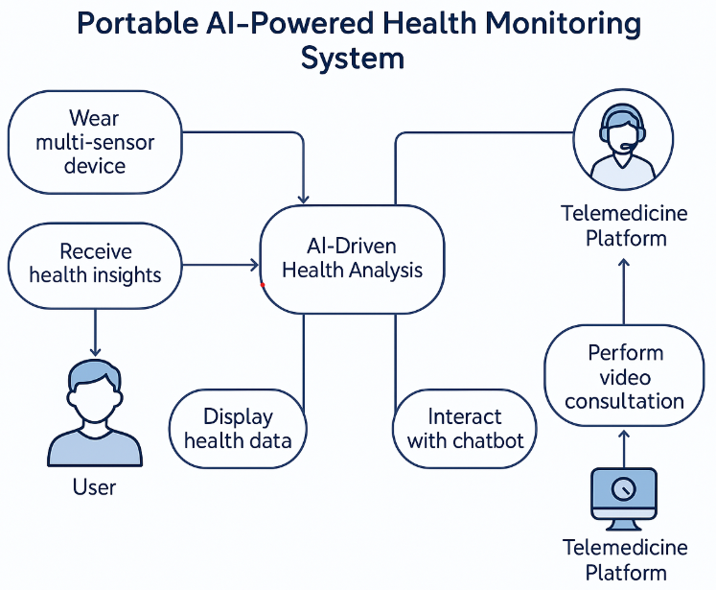
Provide a high-level architecture diagram or a use-case diagram of your proposed solution
graph TD
A[Portable Multi-Sensor Device] -->|Biometric Data| B(Data Acquisition & Preprocessing);
B --> C{Edge AI (TinyML)};
C -- Local Analysis --> D[Real-time Results & Alerts];
C -- Data for Cloud Sync --> E[Cloud Database (Firebase)];
D --> F[Mobile App (React Native)];
E --> G[AI Models (Cloud)];
G --> H[Disease Prediction & Analysis];
H --> E;
F --> I[User Interface & Health Insights];
F --> J[Telemedicine (Twilio API)];
J --> K[Doctors/Healthcare Providers];
I --> L[AI Chatbot (LLM)];
L --> I;
E --> M[Data Analytics & Reporting];
M --> N[Healthcare Organizations/Researchers];
D --> F;

Slide 11
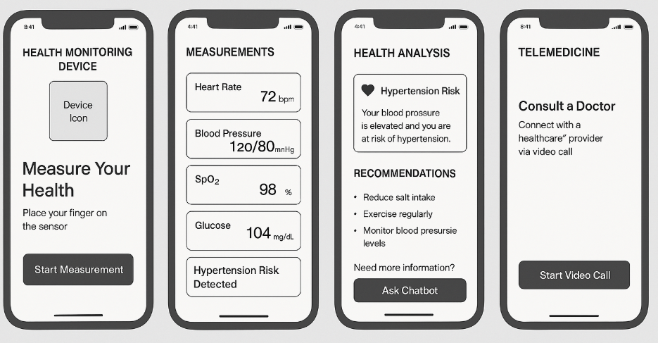
Please share the wireframes/Mock diagrams of the proposed solution (optional)

Slide 12
What datasets will your solution use? Are they publicly available, synthetic, or user-generated?
The solution will use a combination of publicly available medical datasets, synthetic datasets, and user-generated data
Public datasets help train initial AI models and include:
MIT-BIH Arrhythmia Dataset for ECG and heart disease detection
MIMIC-III Database for patient vitals like BP, SpO₂, temperature, etc.
PIMA Indian Diabetes Dataset for diabetes risk prediction
Anemia Dataset from Kaggle for hemoglobin level prediction
Synthetic datasets are generated using data augmentation tools to improve model training where real data is limited
User-generated data is collected from the device in real-time, used for personalized monitoring, and (if permitted) to improve model performance over time
All datasets used ensure privacy, anonymization, and ethical standards
This mixed approach ensures accurate predictions, better generalization, and adaptability for different user groups

Slide 13
Does your solution require cloud-based computation, or can it work with on-device processing? If cloud-based, how do you plan to address connectivity challenges and cost constraints?
On-Device Processing (Primary Mode)
The solution is designed to work effectively even in offline or low-connectivity environments
A lightweight AI model, trained using public health datasets, is deployed on microcontrollers like Raspberry Pi or ESP32
Tools like TensorFlow Lite or Edge Impulse are used to compress and optimize the models for real-time inference
The device processes sensor data locally to predict conditions like:
Arrhythmia or heart diseases (from ECG, heart rate)
Hypertension risk (from blood pressure)
Anemia & diabetes (from hemoglobin and glucose levels)
Lung diseases (from SpO₂ and respiratory rate)
This ensures instant diagnosis without relying on internet access
The results are shown on a small screen or sent to a mobile app using Bluetooth or Wi-Fi

Slide 14
Cloud-Based Computation (Secondary Mode)
When internet is available, the system syncs data to a secure cloud platform
This enables:
Remote access for doctors and health workers
Visualization dashboards
Long-term patient monitoring
Periodic retraining and updates of AI models using collective user data
Cloud usage is optional and lightweight to reduce dependency and cost
Addressing Connectivity Challenges
The device uses an offline-first approach: data is stored locally and only uploaded when a network is available
Automatic sync feature ensures background uploads without user effort
This makes the system suitable for rural areas with intermittent connectivity
Addressing Cost Constraints
Cloud services are used in a minimal way, focusing only on:
Data backups
Model updates
Remote diagnostics
Open-source cloud platforms or low-tier services (e.g., Firebase, AWS Free Tier) help reduce operational costs
Since most computation is handled on-device, the cloud cost remains very low, making the system affordable and scalable

Slide 15
